Slide 1

Introduction to Big Data

Slide 2
What is Big Data?
Big data is data that exceeds the processing capacity of conventional database systems.
The data is too big, moves too fast, or doesn’t fit the structures of your database architectures.
To gain value from this data, you must
choose an alternative way to process it.
https://www.oreilly.com/ideas/what-is-big-data

Slide 3
Definition
“Big data” is
high-volume, -velocity and -variety information assets
that demand cost-effective, innovative forms of information processing
for enhanced insight and decision making
By Gartner

Slide 4
Definition
“Big data” is
high-volume, -velocity and -variety information assets
that demand cost-effective, innovative forms of information processing for enhanced insight and decision making
By Gartner

Slide 5
The Three V-s

Slide 6
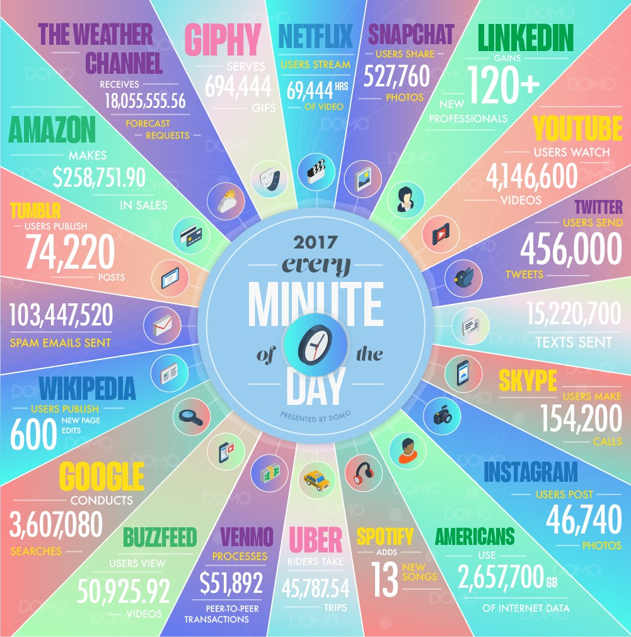
Volume
Quantity of data
Data sets too large to store and analyse using traditional databases
Image Source: https://www.domo.com/blog/data-never-sleeps-5/

Slide 7
Velocity
●
Speed at which data is generated
Speed at which data is moving around and analysed Processing should be faster than generation
Analyse data while it is being generated without even putting it into databases
●
●
●
Image Source: https://www.domo.com/blog/data-never-sleeps-5/

Slide 8
Variety
●
Different types of data that we can use
Generated by different entities
●
○
○
○
Humans
Machines (HW + SW) Sensors
Image Source: https://www.domo.com/blog/data-never-sleeps-5/

Slide 9
Additional V-s

Slide 10
Veracity
●
Messiness or trustworthiness of the data
Volumes makes up for quality
●
Eg. Tweets with spelling mistakes, short words u→you, thr→there, teh→the
○
Image Source: https://www.domo.com/blog/data-never-sleeps-5/

Slide 11
Value
Getting value out of Big Data!!!
Image Source: https://www.domo.com/blog/data-never-sleeps-5/

Slide 12
Definition
“Big data” is
high-volume, -velocity and -variety information assets
that demand cost-effective, innovative forms of information processing for enhanced insight and decision making
By Gartner

Slide 13
Definition
“Big data” is
high-volume, -velocity and -variety information assets
that demand cost-effective, innovative forms of information processing for enhanced insight and decision making
By Gartner

Slide 14
Wikipedia Definition
Big data is a term for data sets that are so large or complex that traditional data processing applications are inadequate…
Challenges include analysis, capture, data curation, search, sharing, storage, transfer, visualization, querying, updating and information privacy. …
The term often refers simply to the use of predictive analytics or certain other advanced methods to extract value from data, and seldom to a particular size of data set. …
Accuracy in big data may lead to more confident decision making, and better decisions can result in greater operational efficiency, cost reduction and reduced risk.

Slide 15
Use cases

Slide 16

Use Case: Big Data in Oil & Gas Drilling
http://analytics-magazine.org/how-big-data-is-changing-the-oil-a-gas-industry/

Slide 17
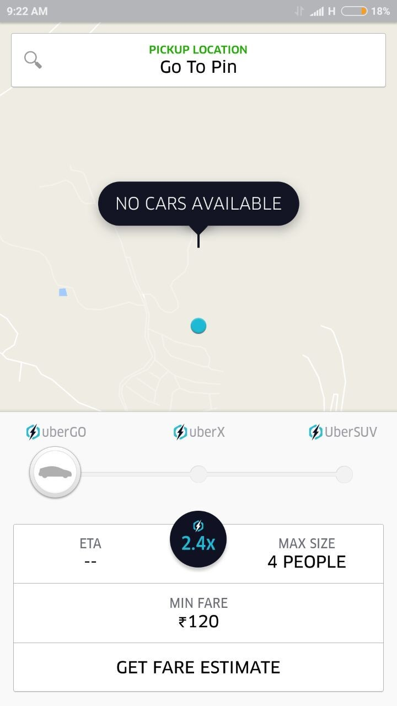
Use Case: Uber - Pay Surge Pricing if Battery is Low
https://www.forbes.com/sites/amitchowdhry/2016/05/25/uber-low-battery/#19762c0474b3

Slide 18
Big Data Challenges

Slide 19


Big Data Challenges: Size does matter
1KB | Kilobyte
1MB | Megabyte
1GB | Gigabyte
1TB | Terabyte
1PB | Petabyte
1EB | Exabyte
1ZB | Zettabyte
1YB | Yottabyte
1 GB = 1 hr
1 TB = 1024 hrs = 102 days
1 PB = 286 yrs > 1 lifetime
1 EB = 293K yrs

Slide 20
data scale, storage, and the immense volume of information.
To illustrate the shift from human-scale data to machine-scale data (the "Velocity" and "Volume" of Big Data) by converting digital storage units (GB, TB, PB, EB) into time-based, human-understandable terms.
Breakdown of the Context
1 GB = 1 hr (Approx. 1 GB/hour): This represents a standard, relatively high-quality continuous stream, such as streaming HD video or high-definition logging.
1 TB = 1024 hrs = 102 days: Extrapolating the 1 GB/hr rate, a Terabyte of data represents roughly three months of continuous, 24/7, high-volume data generation (e.g., IoT sensor logs or security camera footage).
1 PB = 286 yrs > 1 lifetime: A Petabyte represents a massive amount of data, exceeding a human lifespan at the same generation rate, illustrating the transition to data that requires automated, distributed processing (Big Data).
1 EB = 293K yrs: An Exabyte (1,000+ PB) represents an amount of data that would take nearly 300,000 years to generate at that same rate, emphasizing the enormous scale of modern data centers and internet traffic.
The overall theme is to demonstrate that as data moves into Petabytes and Exabytes, it is no longer manageable by traditional means, requiring Big Data technologies like Hadoop or Spark.

Slide 21




Big Data Challenges: Vertical Vs Horizontal Scaling
Vertical Scaling
Horizontal Scaling

Slide 22
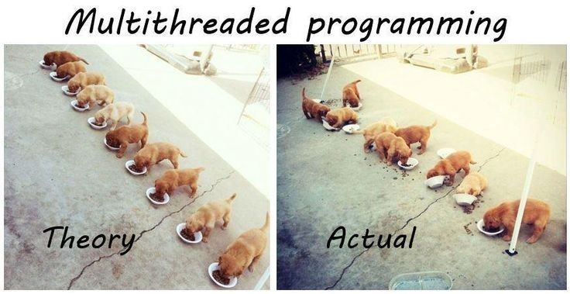
Big Data Challenges
Scaling
Source:
https://s-media-cache-ak0.pinimg.com/736x/10/0c/d0/100cd0da1c19e5d6f850ed23c3633714.jpg

Slide 23
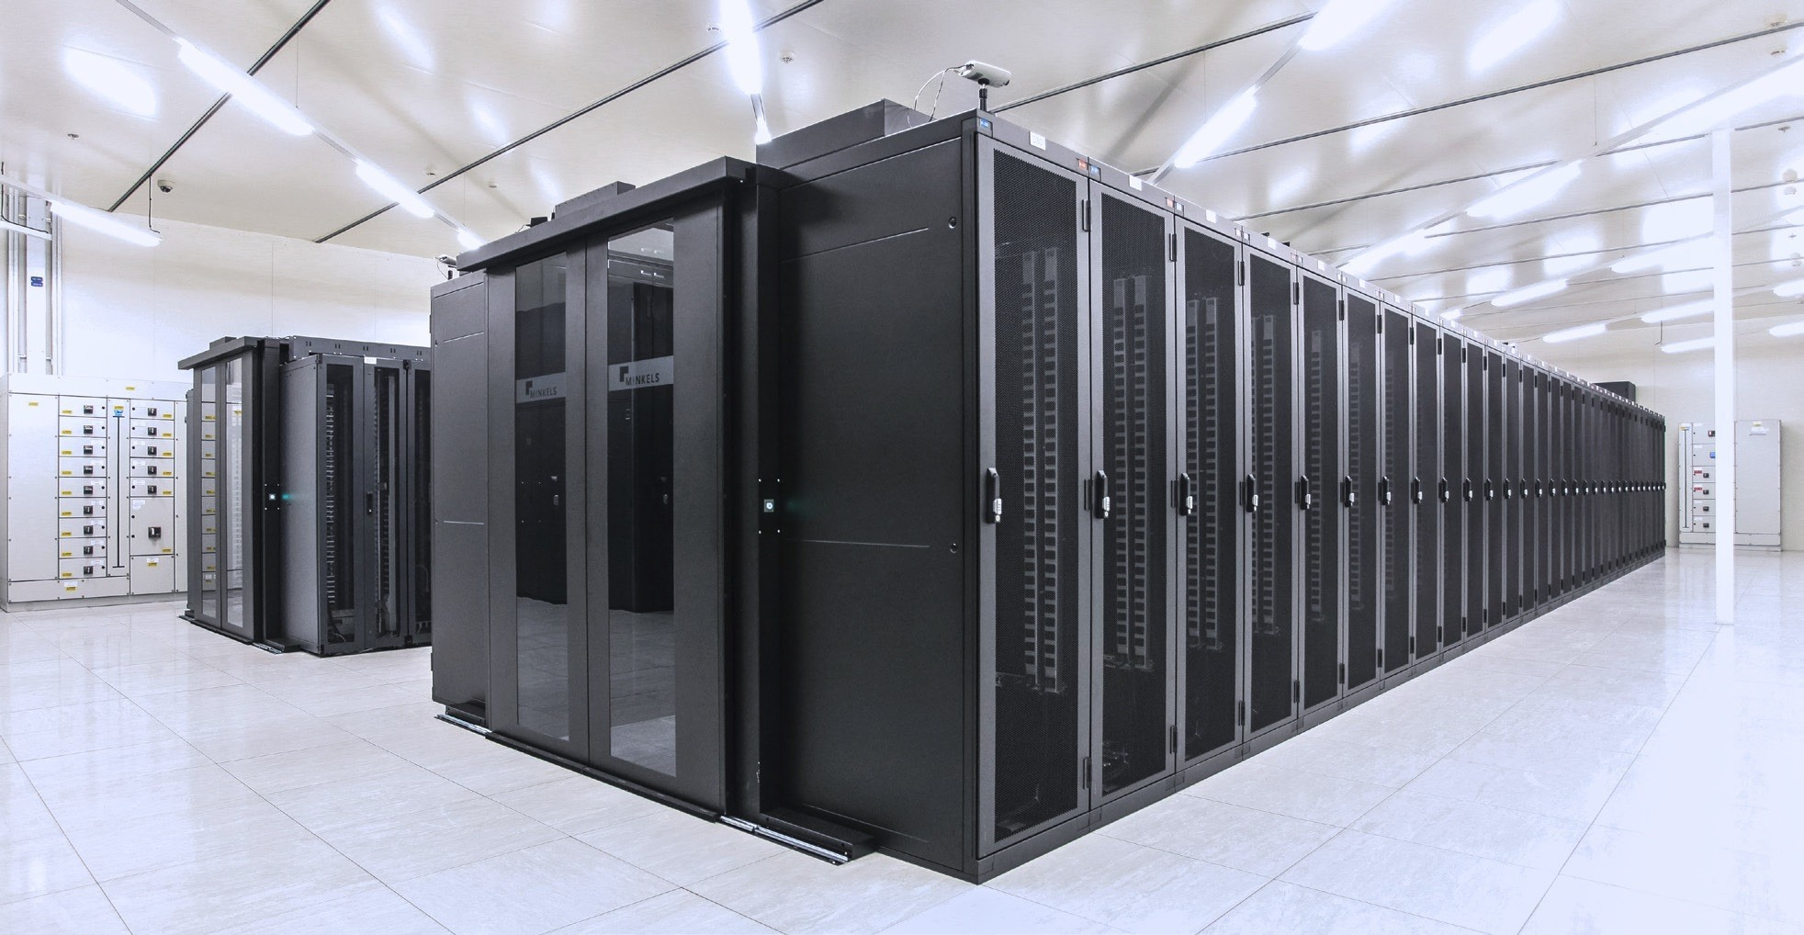
Big Data Challenges: Scale of infrastructure
Image Source: https://datacenter.legrand.com

Slide 24
Further Reading
●
●
●
●
●
●
●
●
●
●
A Brief History of Big Data Everyone Should Read
Beyond Volume, Variety and Velocity is the Issue of Big Data Veracity What is big data? - OpenSource.com & O’Reilly
Uber Use Case
5 Big Data Use Cases To Watch Best Big Data Analytics Use Cases
The 5 game changing big data use cases Big Data - The 5 Vs Everyone Must Know Top SlideShare Presentations on Big Data Google Data Center 360° Tour

Slide 25

Questions?

Slide 26
How to store huge files?

Slide 27
Requirements?
Efficient Access
Effective utilization of space
Redundancy (Failsafe)
Given: probability of 1 disk failing is 1% per year
What are the chances that 1 out of 10³ disk fails at a data center? - Let’s calculate
Notes:
https://blog.datamaster.hr/disk-failure-probability/#:~:text=Introduction,will%20fail%20within%20one%20year

Slide 28
from scipy.stats import binom
# Parameters
n = 1000
p = 0.01
k = 1
# Probability of exactly 1 failure
prob_exactly_1 = binom.pmf(k, n, p)
# Probability of at least 1 failure (often what users actually mean in reliability)
prob_at_least_1 = 1 - binom.pmf(0, n, p)
print(f"{prob_exactly_1=}")
print(f"{prob_at_least_1=}")
Notes:
The probability of exactly one disk failing out of is approximately 0.0436, while the probability of at least one disk failing is virtually certain at 99.996 or 1 in 2293.

Slide 29
HDFS
Hadoop distributed File System

Slide 30
HDFS
Data storage system used by Hadoop
Hadoop: Project to develop open-source software for reliable, scalable, distributed computing★
Will discuss Hadoop later
Components
Architecture
Tasks / Services
★ http://hadoop.apache.org/

Slide 31



Components of HDFS
Secondary NameNode
Active NameNode
Standby NameNode
DataNodes

Slide 32
Terminology
●
●
●
HDFS: Hadoop Distributed File System
Datanode: A DataNode stores data in HDFS.
Namenode: The centerpiece of an HDFS file system.
○
○
Keeps the directory tree of all files in the file system Tracks where across the cluster the file data is kept.
Does not store the data of these files itself.
Active : Actively serving request
Standby: Becomes Active if the current Active node fails
○
○

Slide 33
Terminology
●
Secondary Namenode:
○
○
helper node for namenode
Puts a checkpoint in filesystem which will help Namenode to function better

Slide 34
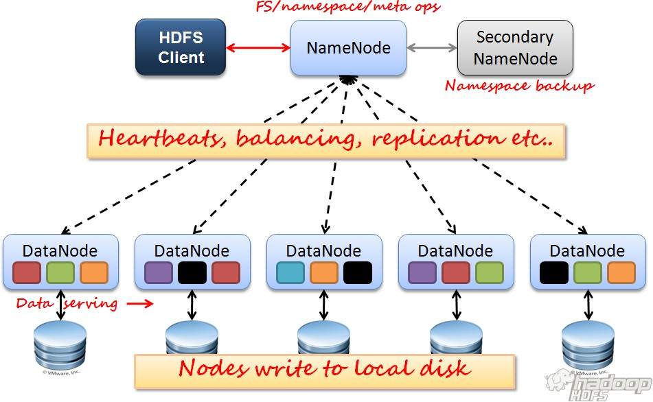
A
r c h i t e c t u r e

Slide 35
Storing file on HDFS
Motivation: Reliability, Availability , Network Bandwidth
The input file (say 1 TB) is split into smaller chunks/blocks of 128 MB
The chunks are stored on multiple nodes as independent files on data nodes

Slide 36
Storing file on HDFS
To ensure that data is not lost, data can typically be replicated on:
➢
➢
➢
➢
local rack
remote rack (in case local rack fails) remote node (in case local node fails)
randomly
Default replication factor is 3

Slide 37
Storing file on HDFS
Default replication factor is 3
first replica of a block will be stored on a local rack
the next replica will be stored on a remote rack
the third replica will be stored on the same remote rack but on a different Datanode
Why?
More replicas?
the rest will be placed on random Datanodes
As far as possible, no more than two replicas are kept on the same rack

Slide 38


Master Node
File
B1
B2
B3
Bn
Blocks
8 gigabit
1 gigabit
B1
Data nodes
B2
B1
B2
B2
B1
Rack 1
Rack 2

Slide 39
Tasks of NameNode
Manages File System
mapping files to blocks and blocks to data nodes
Maintaining status of data nodes
Heartbeat
■
■
Datanode sends heartbeat at regular intervals
If heartbeat is not received, datanode is declared dead
➢
Blockreport
■
■
DataNode sends list of blocks on it Used to check health of HDFS

Slide 40
NameNode Functions
Replication
Rebalancing - balancer tool Addition of new nodes Decommissioning Deletion of some files
➢
➢
➢
On Datanode failure On Disk failure
On Block corruption
➢
➢
➢
Data integrity
Checksum for each block
Stored in hidden file

Slide 41
HDFS Robustness
Safemode
➢
➢
➢
At startup: No replication possible
Receives Heartbeats and Blockreports from Datanodes
Only a percentage of blocks are checked for defined replication
factor
Replicate blocks wherever necessary
All is well ☺ ➔ Exit Safemode

Slide 42
HDFS Summary
Fault tolerant
Scalable
Reliable
File are distributed in large blocks for
➢
➢
Efficient reads Parallel access

Slide 43
Questions?

